Slide 1
Austin Texas Crime Trends

Slide 2
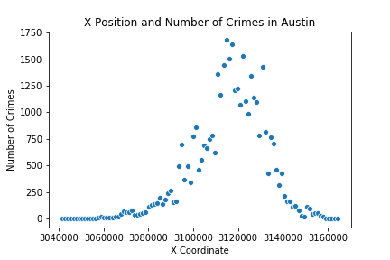
Which side of austin has the most crime?
Crimes seem to be evenly centered

Slide 3
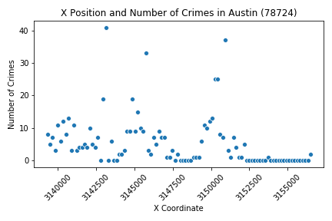
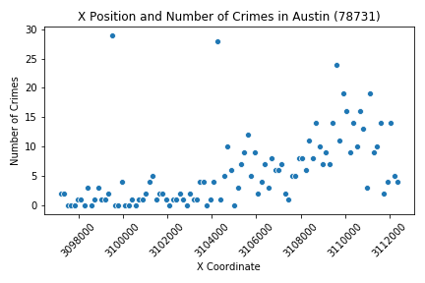
Which side of each zip code has the most crime?
Some zip codes have high correlation
Some have little correlation
The correlation could be caused by zip code shape or population density

Slide 4
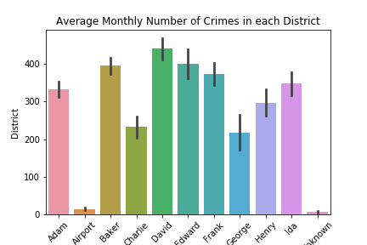
Mean Monthly Crime for Each District
The David district has the highest crime rate
The Airport has the lowest crime rate
The George district has the lowest crime rate but the highest standard deviation

Slide 5
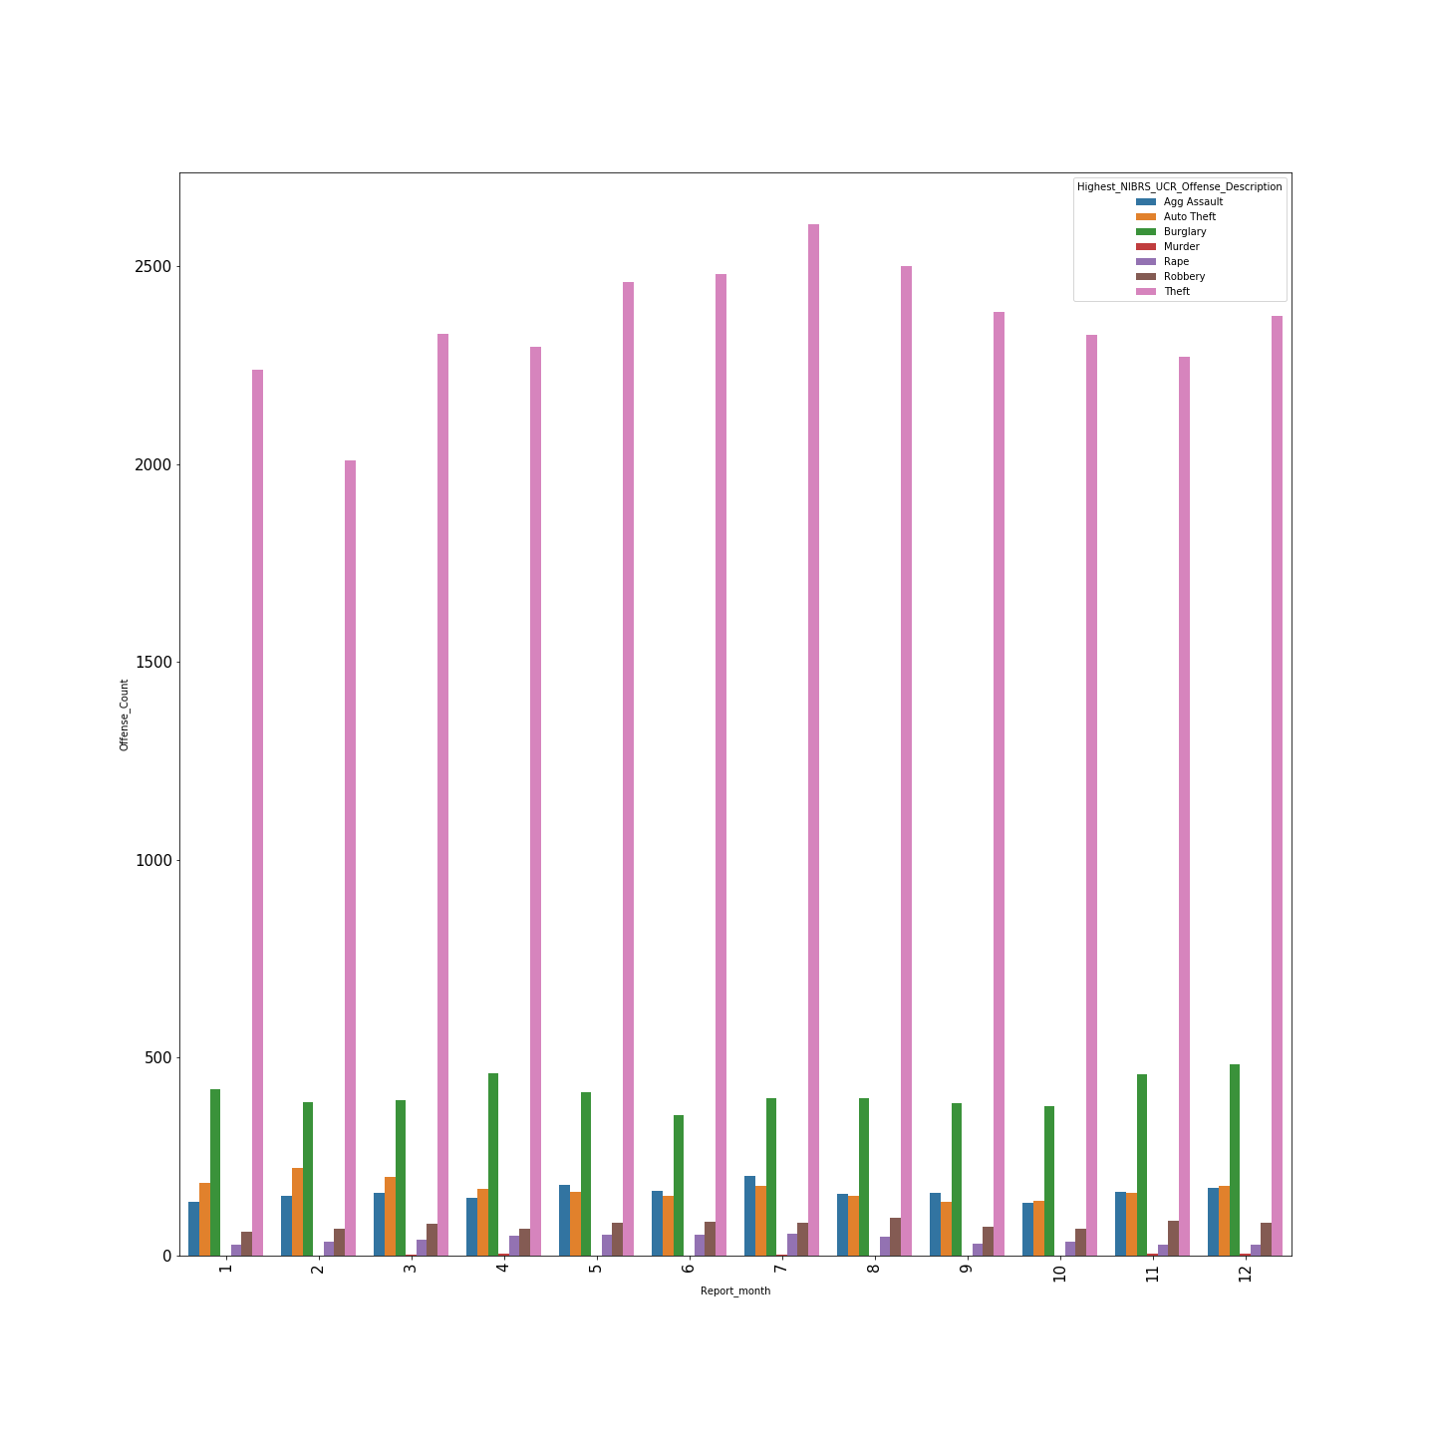
Offense Count/month
Grouped the data based on
report Dates and aggregated based
On types of crimes.
Burglary was highest in
December and Theft is highest in
July.

Slide 6
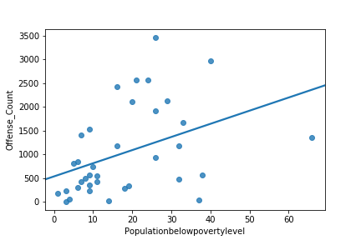
Tried to find correlation between poverty level and amount of crimes.
Clearly can’t see a good correlation

Slide 7
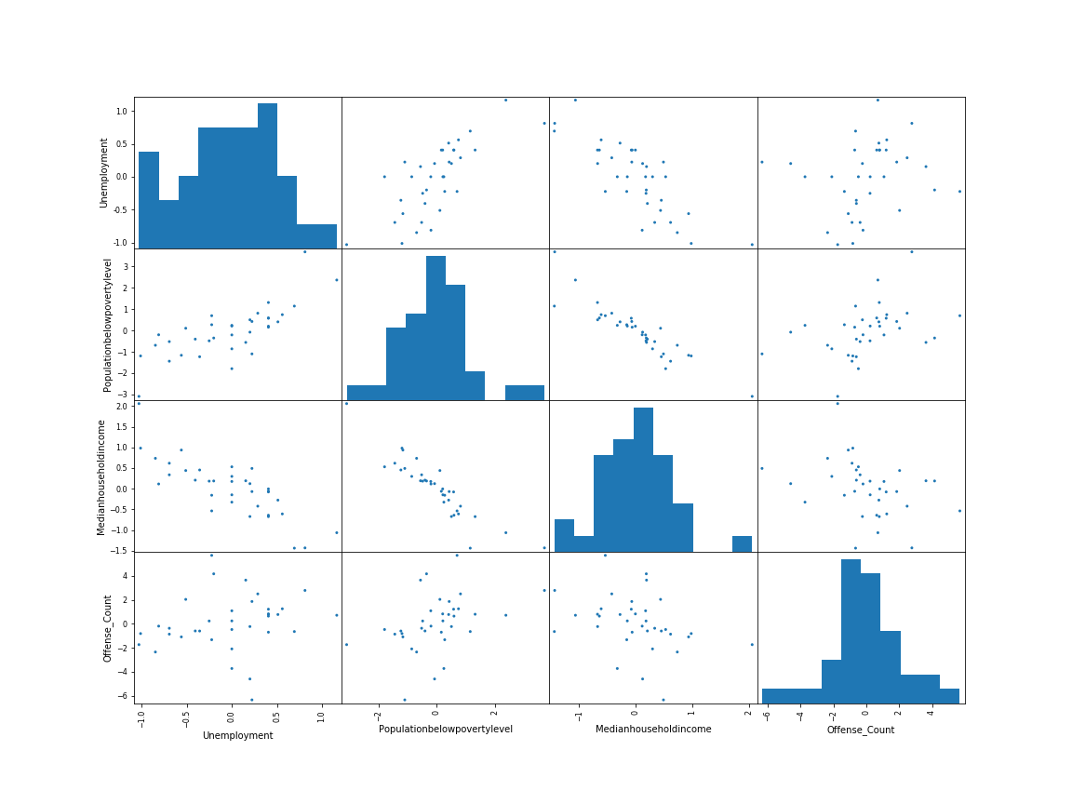

Slide 8
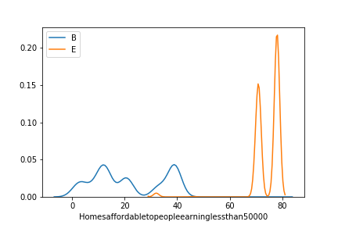
Homes affordable for people earning<50,000$
As the p-value is less than 0.05 we reject the null hypothesis that there is no difference between the means and conclude that a significant difference does exist between the amount of homes affordable for people earning under $ 50,000 in the Baker District and the Edward District.

Slide 9
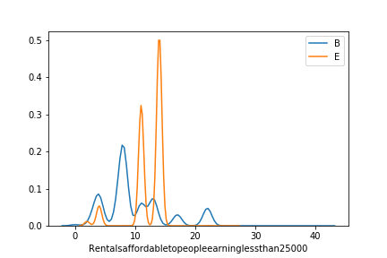
Rentals affordable for people earning<25,000$
As the p-value is greater than 0.05 we cannot conclude that a significant difference exists between the amount of homes affordable for people earning under $ 25,000 in the Baker District and the Edward District.

